Slide 1
Arrakis: The Operating System is the Control Plane
Simon Peter Jialin Li Irene Zhang Dan R. K. Ports DougWoos
Arvind Krishnamurthy Thomas Anderson Timothy Roscoe
Review by
Swayanshu shanti Pragnya

Slide 2
Related Work
Libraries in 90's (Exokernel, Nemesis)
Kernel Bypass(Net map, U-net)
High performance I/O status(Sandstorm, mTCP)
Classical OS server features
    Process protection
    Resource limit
    Flexibility of I/O protocol
    Global naming

Slide 3
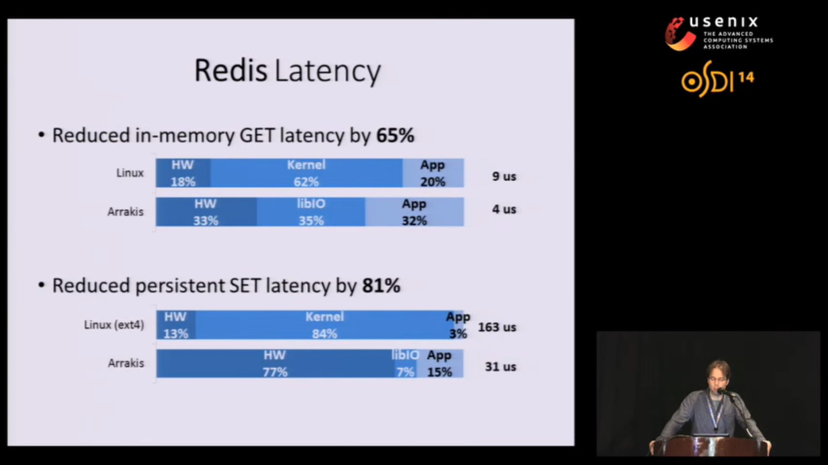
Data Centre Harbour Technology
Dell Poweredge r5 20(evaluation)
Ethernet controller + rate controller(1 gigabyte cache memory) + CPU(6 cores 2.2GHz) = $1200
Can’t we just use Linux?

Slide 4
Process to skip Kernel
Erlier data path process
Redis
API
I/O processing
Kernel
Naming
Resource Limits
Access control
I/O devices
Copying
protection
Multiplexing
Redis
Kernel
Api, Access control , Multiplexing
Naming, I/O scheduling
I/O processing Copying
protection Resource Limits
I/O devices

Slide 5
Goal of ARRAKIS
Skipping Kernel
Deliver I/O work directly to the applications
OS = Control Plane + Data Plane
Redis
API
I/O processing
Kernel
Naming
Resource Limits
Access control
Data Path
I/O devices
  Copying
  protection
  Multiplexing

Slide 6
Drawbacks
Improvement in web requests (which port not mentioned)
Redis interface (directly access input and send, but how?)
No global naming (virtual storage but how?)
Virtual memory protection

